Slide 1
Advanced Network Design EETS8332
Spring 2013
Session 1
© Dr. Scott Kingsley

Slide 2
Dr. Scott Kingsley Bio
Employment
U.S. Navy
DSC Communications
MCI Telecommunications
Alcatel Networking Systems
Education
BS Electronics
MS Telecommunications
Doctor of Engineering
Entrepreneur
TelOptica, Inc.
OptionTel, LLC
Teaching
DeVry/Keller
Frequent guest lecture at Texas A&M telecom
Various others
Organizations
IEEE
ITERA
ASEE
© Dr. Scott Kingsley

Slide 3
Past
IP
ATM/FR
T-1/T-3/SONET

Slide 4
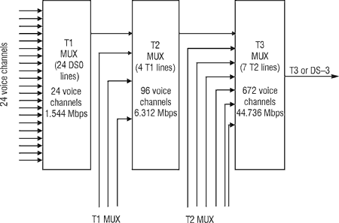
North American Digital Hierarchy
© Dr. Scott Kingsley

Slide 5
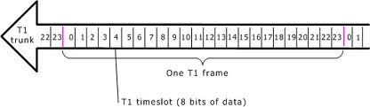
Digital Transport: Channelized T-1
© Dr. Scott Kingsley

Slide 6
T-3
28 x T-1
Proprietary
© Dr. Scott Kingsley

Slide 7
NADH Problems
Clocking variation
“Black box”
Back-to-back multiplexers
Speed limitations
© Dr. Scott Kingsley

Slide 8
SONET/SDH
SONET/SDH as part of the first generation of optical networks was the earliest to be deployed in backbone networks and has been very successful over the years.
It is particularly adept at supporting constant bit rate (CBR) connections, and it multiplexes these connections into higher speed optical connections by using time division multiplexing.
Originally designed for low speed voice and CBR connections, up to 51 Mb/s, it now supports data network, packet traffic that can have link transmission rates in the tens of gigabits per second.
An important feature of SONET/SDH is that it provides carrier grade service of high availability.
© Dr. Scott Kingsley

Slide 9
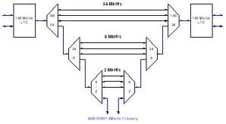
Plesiochronous Networks
Plesio means near
Equipment has very accurate but not synchronized clocks
North American Digital Hierarchy
CSU/DSU provides clock
Disadvantages
Speed limited
Payload invisible
© Dr. Scott Kingsley

Slide 10
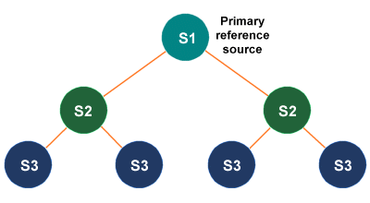
SONET Synchronization
In SONET, all clocks in the network are locked to a master clock.

Slide 11
SONET Advantages
Multiplexing simplicity and transparency
Management capabilities
Interoperability (standardization)
Network availability
© Dr. Scott Kingsley

Slide 12
SONET Advantages
Multiplexing simplicity and transparency
Management capabilities
Interoperability (standardization)
Network availability
© Dr. Scott Kingsley

Slide 13
SONET Specifications
Defines electrical & optical signal interfaces
Electrical
Multiplexing, regeneration performed in electrical domain
STS – Synchronous Transport Signals defined
Very short range (e.g., within a switch)
Optical
Transmission carried out in optical domain
Optical transmitter & receiver
OC – Optical Carrier

Slide 14
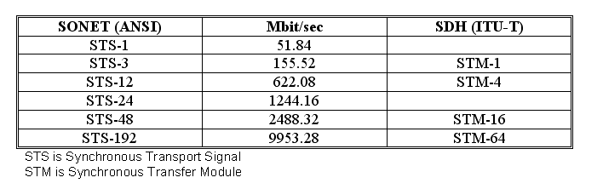
SONET/SDH Hierarchy

Slide 15
SONET STS-1 frame
Each STS-1 frame is 90 columns * 9 rows of bytes = 810 bytes
There are 8000 STS-1 frames per second
so each byte represents 64 kbps (each column is 576 kbps)
Thus the basic STS-1 rate is 51.840 Mbps
90 columns
9 rows

Slide 16
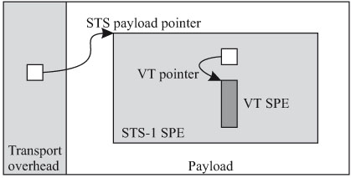
SONET Pointers

Slide 17
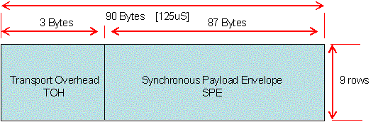
SONET STS-1 Frame

Slide 18
SONET Virtual Tributaries (VTs)
SONET is designed to carry broadband payloads. Current digital hierarchy data rates, however, are lower than ST-1. To make SONET backward-compatible with the current hierarchy, its frame design includes a system of virtual tributaries (VTs). A virtual tributary is a partial payload that can be inserted into an STS-1.

Slide 19
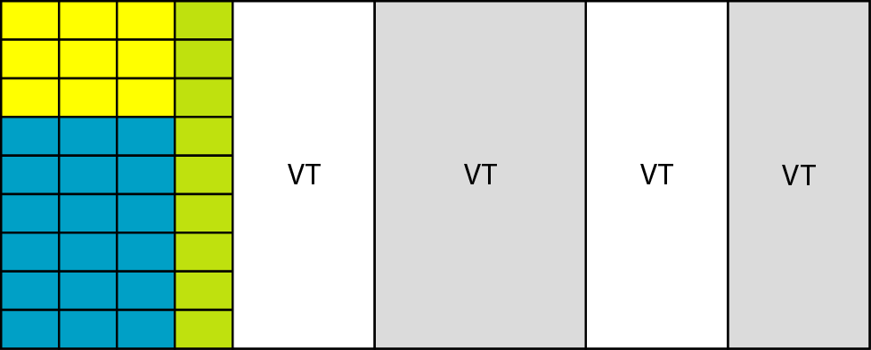
SONET Virtual Tributaries (VTs)

Slide 20
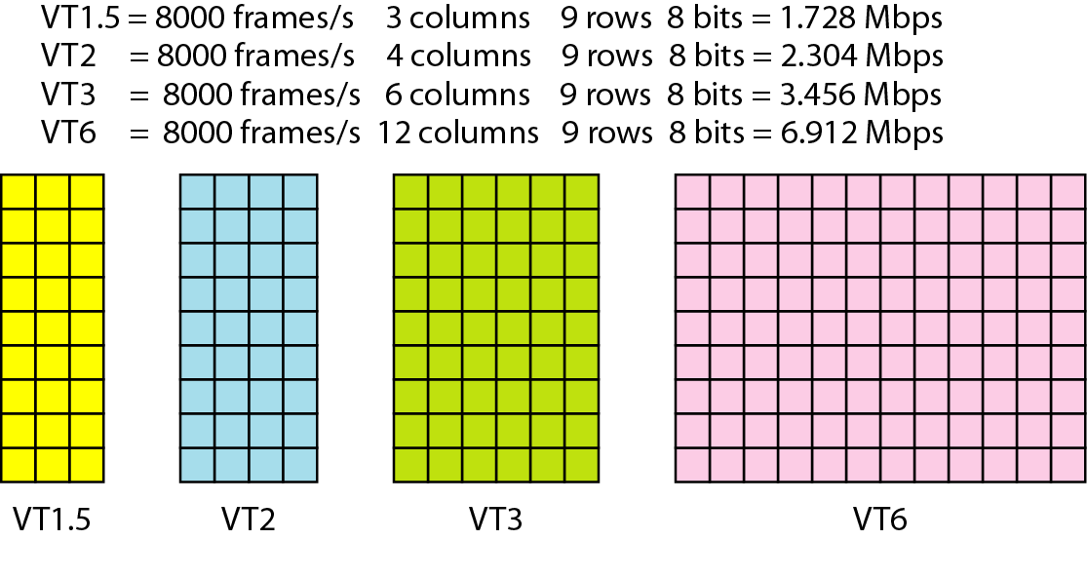
SONET Virtual Tributaries (VTs)

Slide 21
SONET Virtual Tributaries
VT size | Rate | Payload
VT 1.5 | 1.728 Mbps | DS1 (1.544 Mbps)
VT 2 | 2.304 Mbps | E1 (2.048 Mbps)
VT 3 | 3.456 Mbps | DS1C (3.152 Mbps)
VT 6 | 6.912 Mbps | DS2 (6.312 bps)
Standard PDH rates map efficiently into SONET

Slide 22
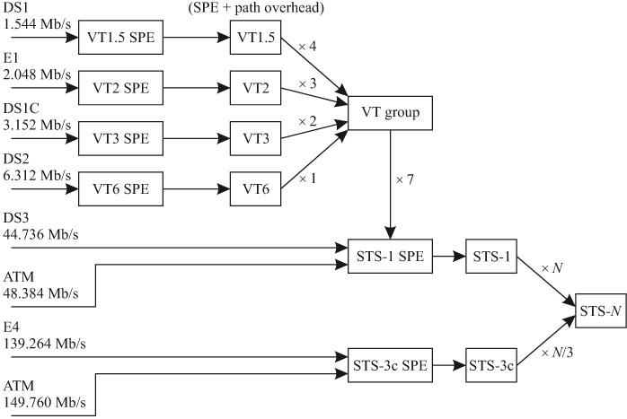
SONET Virtual Tributaries

Slide 23
SONET Equipment
Terminal Multiplexer (TM)
Add-Drop Multiplexers (ADM)
Digital Cross-connect System (DCS)
Regenerator and Amplifiers

Slide 24
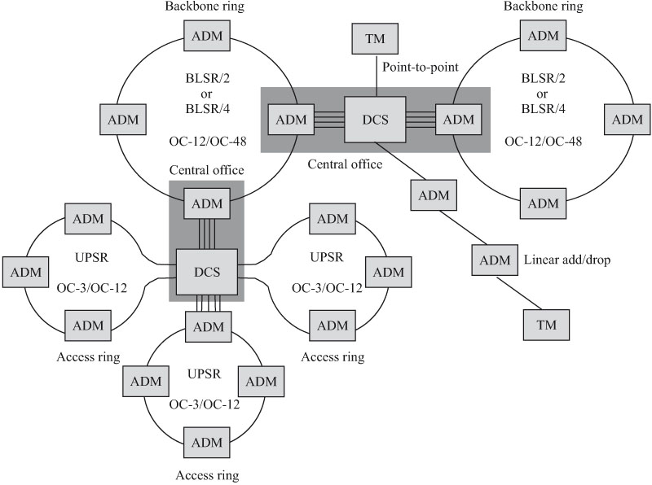
SONET Equipment Review

Slide 25
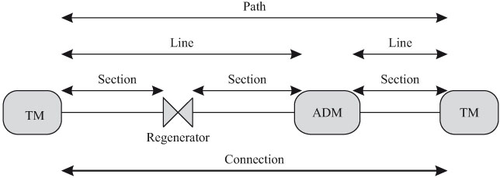
SONET Layers

Slide 26
SONET Layers
Path
Path
Line
Line
Line
Line
Section
Section
Section
Section
Section
Section
Section
Physical
Physical
Physical
Physical
Physical
Physical
Physical

Slide 27
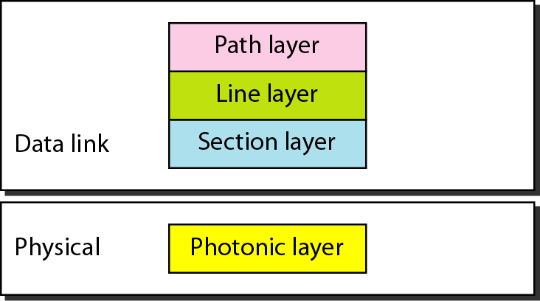
SONET and OSI Layers

Slide 28
SONET STS-1 frame
Each STS-1 frame is 90 columns * 9 rows of bytes = 810 bytes
There are 8000 STS-1 frames per second
so each byte represents 64 kbps (each column is 576 kbps)
Thus the basic STS-1 rate is 51.840 Mbps
90 columns
9 rows

Slide 29
SONET STS-1 Frame

Slide 30
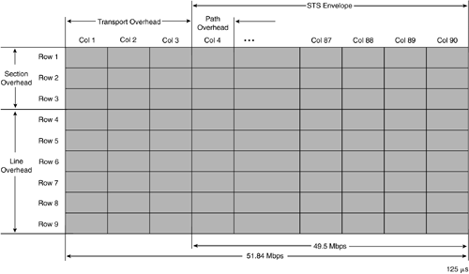
SONET STS-1 Frame

Slide 31
END SESSION 1

